Slide 1
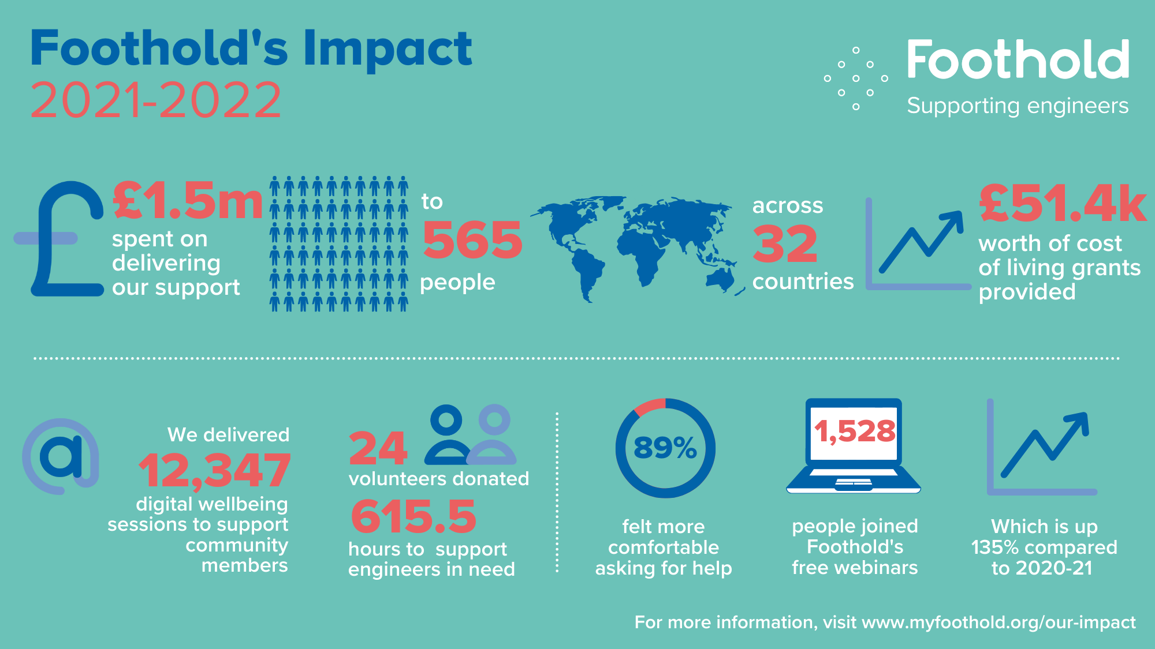
Notes:
Foothold have been supporting IET (Institution of Engineering and Technology) members and their families to thrive – no matter what life throws at them – since 1890.
The charity’s ambition has always been to ensure that engineers feel supported in all aspects of their lives, and know that it’s okay to ask for that support. So that they can be healthy and able to stand on their own two feet. Feeling looked after, but also empowered by their professional community.
Which is why, throughout their 130-year history, they have continually developed vital services which support around 1,000 people every year, right across the globe.
Foothold exist to ensure that no engineer or their family needs to face life’s challenges alone. Funded by engineers, for engineers, Foothold is here for engineers and the people who matter to them most. Whatever the problem, big or small.

Slide 2
Notes:
Foothold offer varied, holistic and tailored support to the global engineering community.
Whether it’s bespoke grants to help struggling families get back on their feet; advice and guidance on home and workplace issues from our expert partners; or digital resources to help people take control of their wellbeing, they provide a helping hand so that engineers and their families can meet their needs emotionally, physically, and financially.
Their expansive digital support enables the charity to be there for many more people than they can through our direct support alone. Through their free Wellbeing Hub, webinars, blogs and app, Foothold empower engineers to build their resilience to life’s challenges and take control of their health and wellbeing.

